Slide 1
Student Directory – Team Yellow
William Barber, Josh Black, Amber Moszenski, Austin Farmer

Slide 2
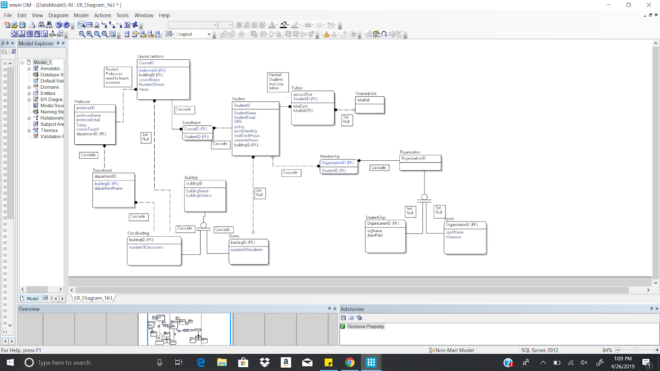
Project Description
Simulates a student focused database as school directory
Includes tables such as Student, Course Sections, Professors, Organizations, etc.

Slide 3
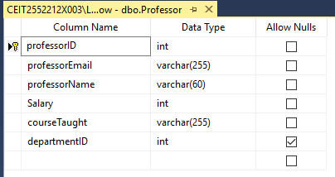
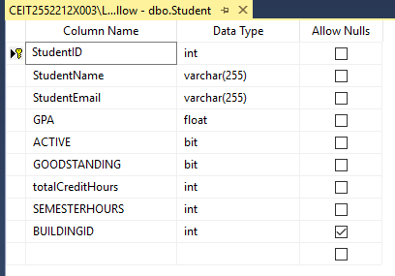
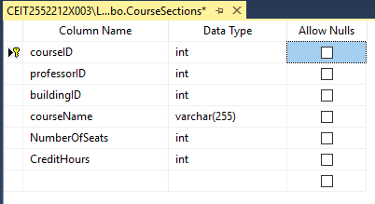
Data Tables

Slide 4
Software
MS SQL Server + HTML, CSS, Javascript

